Slide 1
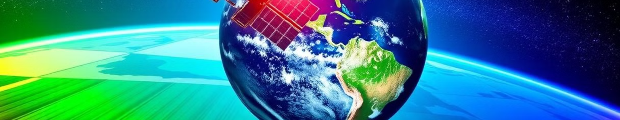
Team: Astro Nexis
Agricultural Decision Making
Leveraging Earth Observation Data for Informed Agricultural Decision-Making
Mohammed Amirul Aman S Nithin Rakshit Koppad
Rakesh R Angadi Sainath Ravi Kiran

Slide 2
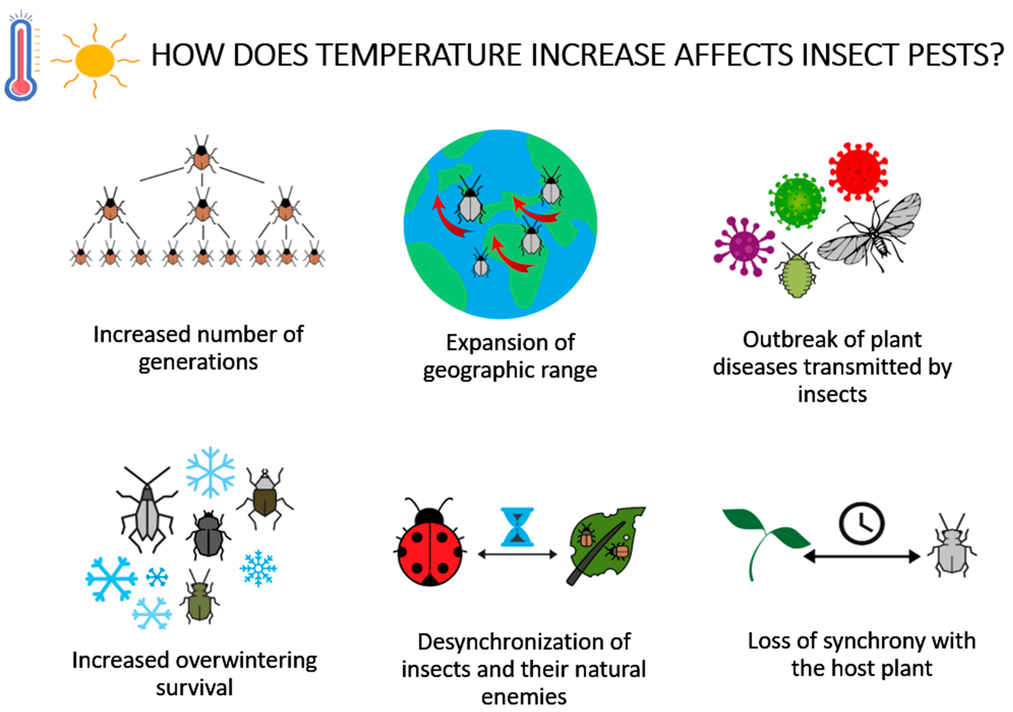
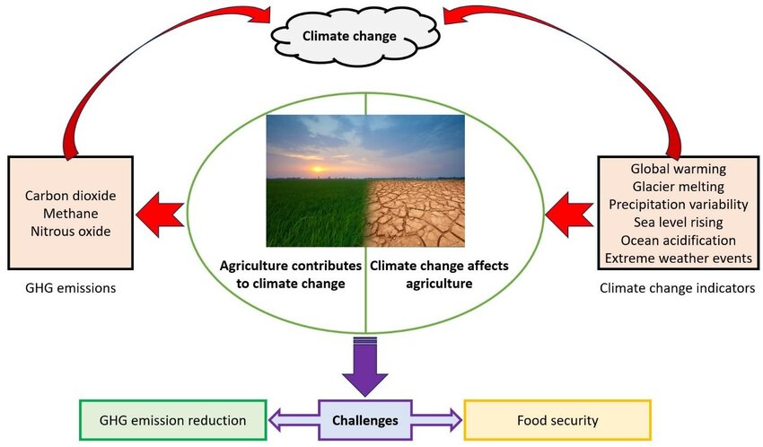
Astro Nexis
Challenges faced by Farmer due to Climate Change
The Farmers face Water Related Challenges due to unpredictable weather, pest and some diseases
These factors can significantly impact crop health, farmers’ profits, and food security
Sometimes farmers may face droughts or floods. Our App Takes the Consideration of these problems and comes with the Best Solution to tackle the
climate changes through our App.

Slide 3
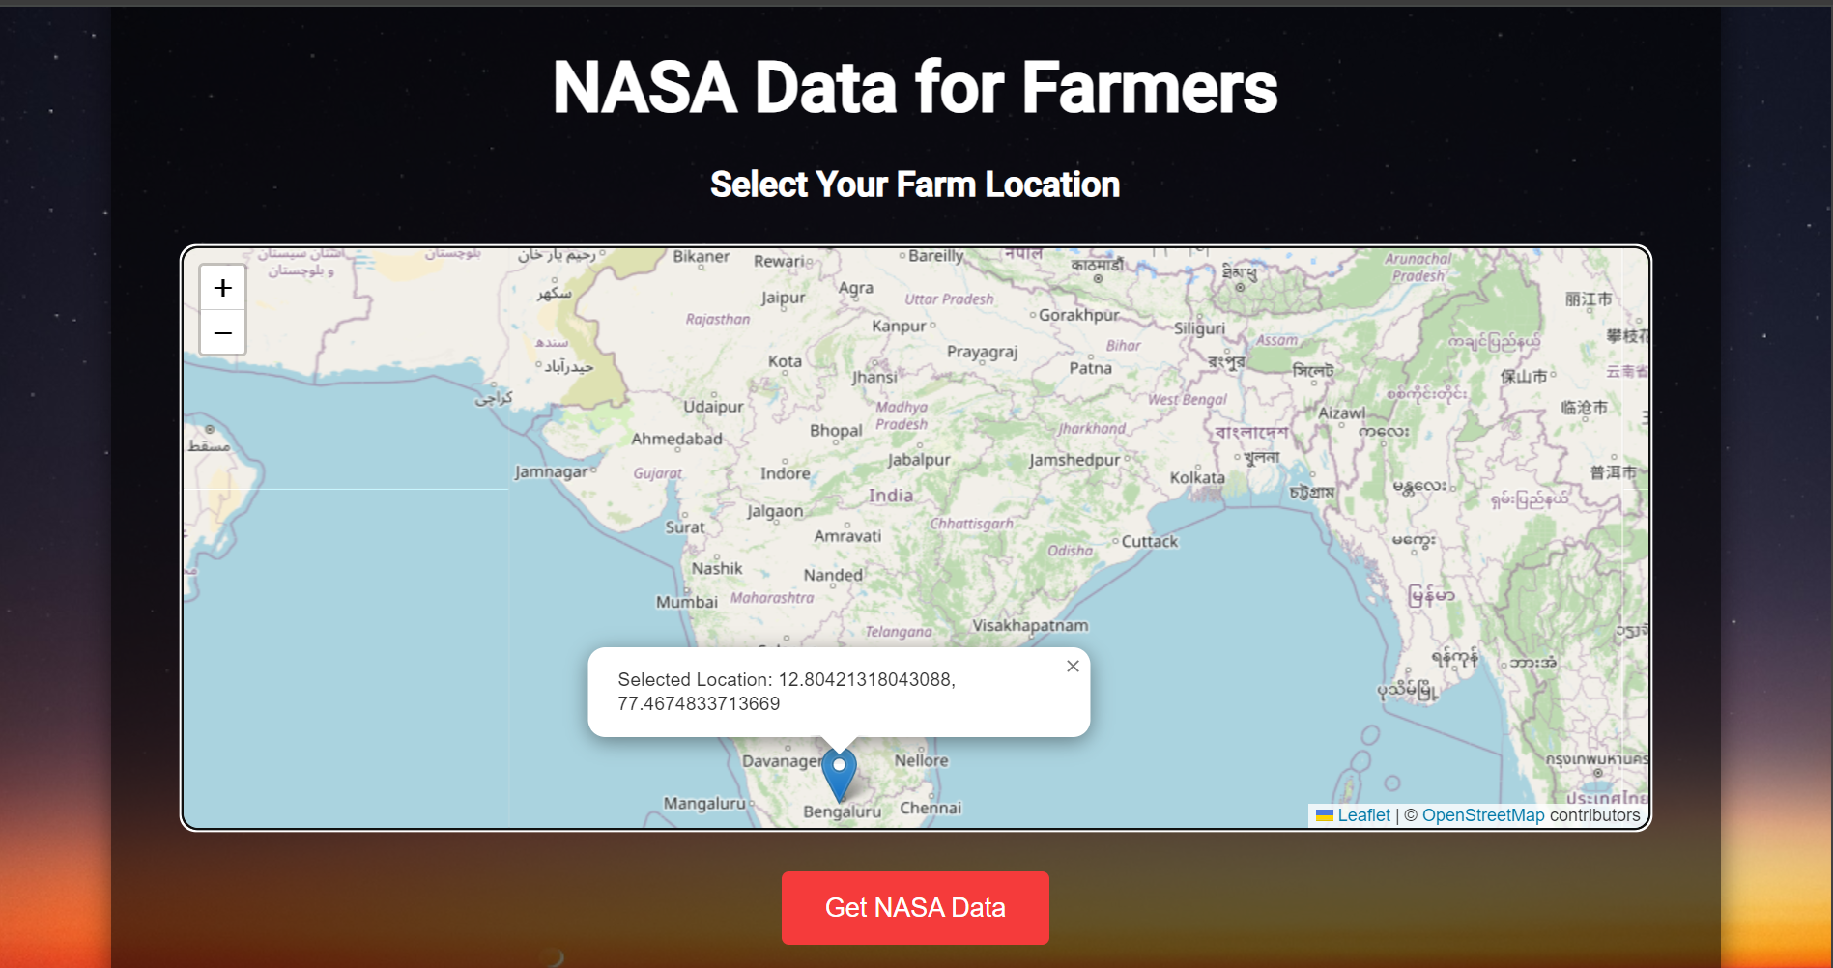
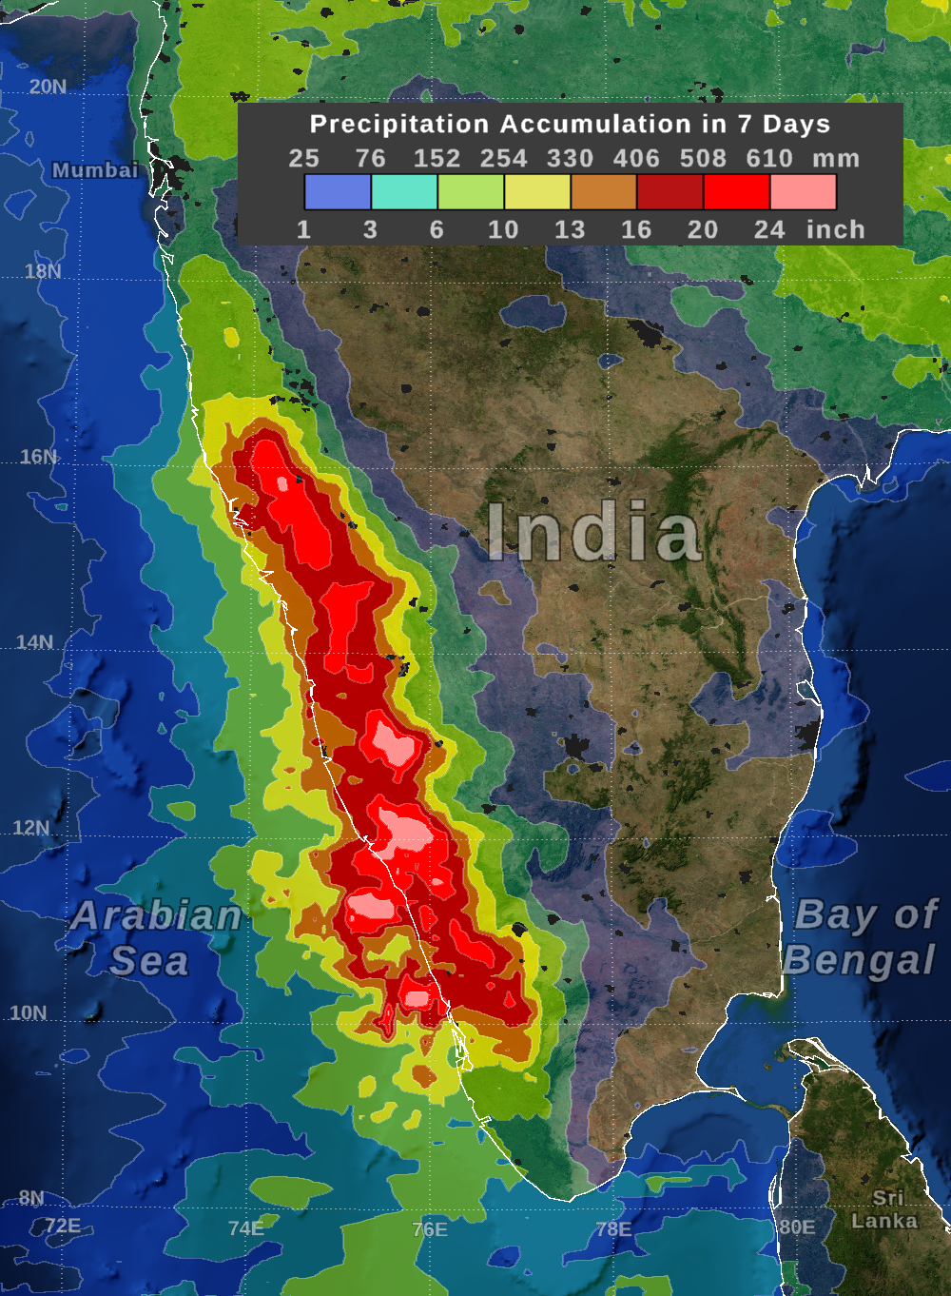
Astro Nexis
Observations that benefit the Farmers
Farmer face problems from Rainfall, The Problem can tackled from our App
Our App provides the Farmer with the feature of map facility where he/she could see the Climate changes and make Clear Decisions

Slide 4
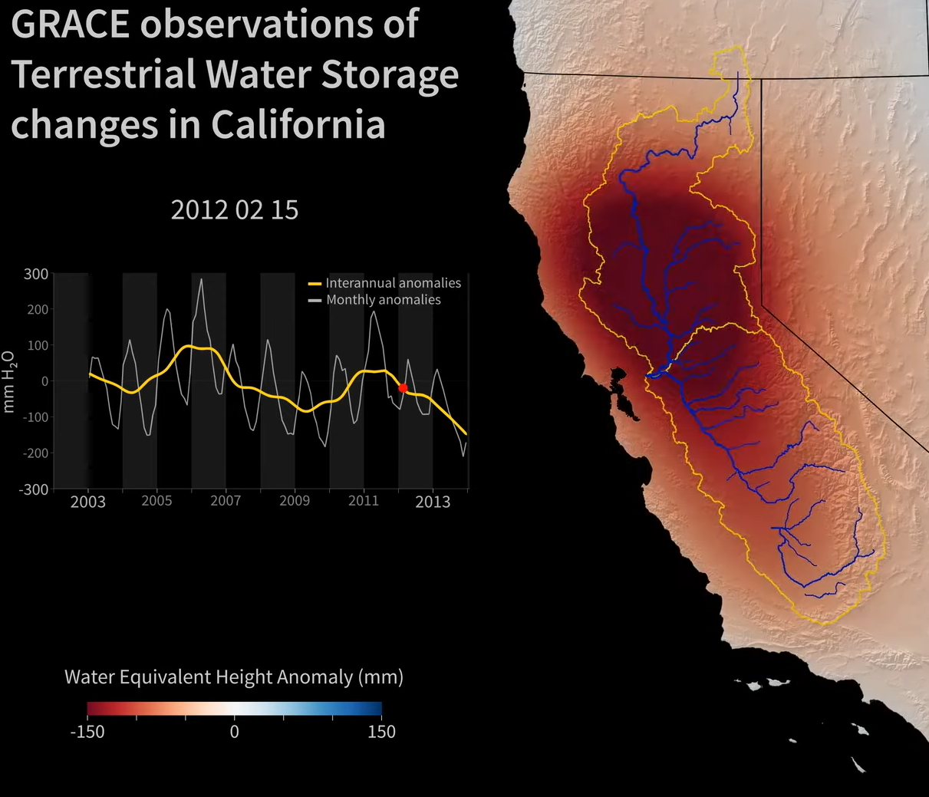
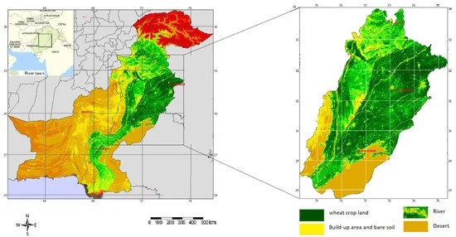
Astro Nexis
Observations that benefit the Farmers
O Our App has the integrated data of the GRACE
which helps the Farmer to take the correct decisions according to his/her Crop status.
And the app facilitates to see the crop distributions over the place

Slide 5
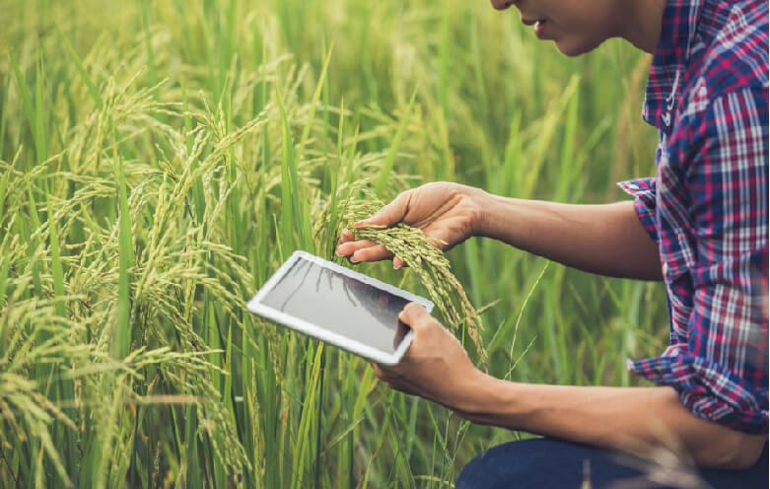

Astro Nexis
Problems that can be solved …
App provides the crystal clear data to solve this Floods Issue
The App has the features to check the condition of the plants and the data related diseases and the pests that affect the plant.

Slide 6
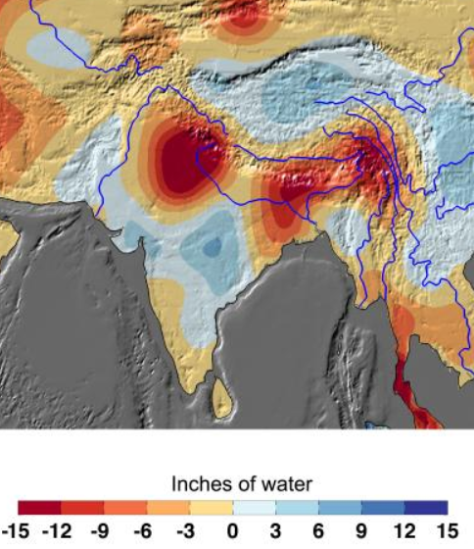
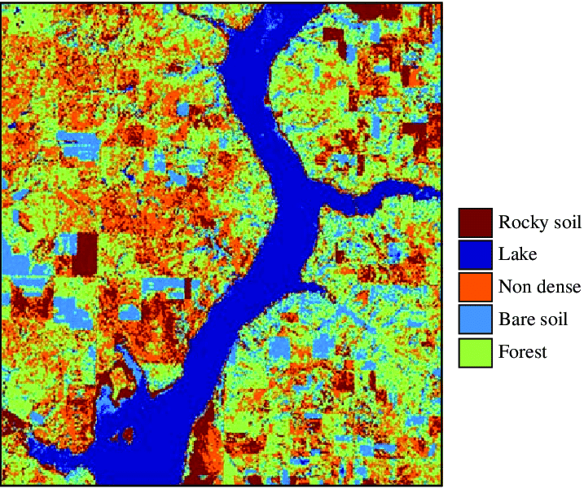
Astro Nexis
Irrigation and the Soil feature of our App
App provides the soil data over the region and helps the Farmer in decision making in type of crop he need to grow
The data derived from the App helps Farmer to optimize the irrigation schedules, reducing water waste and maximizing crop yields.

Slide 7
Summary
Astro Nexis
App is build on Models of irrigation, flood, soil, crops over region models.
Our App provides the data of the plants ,fertilizer usage and the weather related data over the region and has the integrated date of the GRACE.
HAPPY FARMER’S HAPPY WORLD!!!
GitHub Link: https://github.com/AmeerulAman1/Astro_Nexis

